Slide 1


Notes:
Vision and Purpose of MSA:
Making industry training accessible for ALL students
Making work experience more attainable / First foot in the door for students to get experience
Bridging the skills gap between university and the workplace.
MSP driven initiative supported by Microsoft.
Students 95%
We have a minimum compensation expectation from employers
We don't do any of the legal/HR stuff

Slide 2


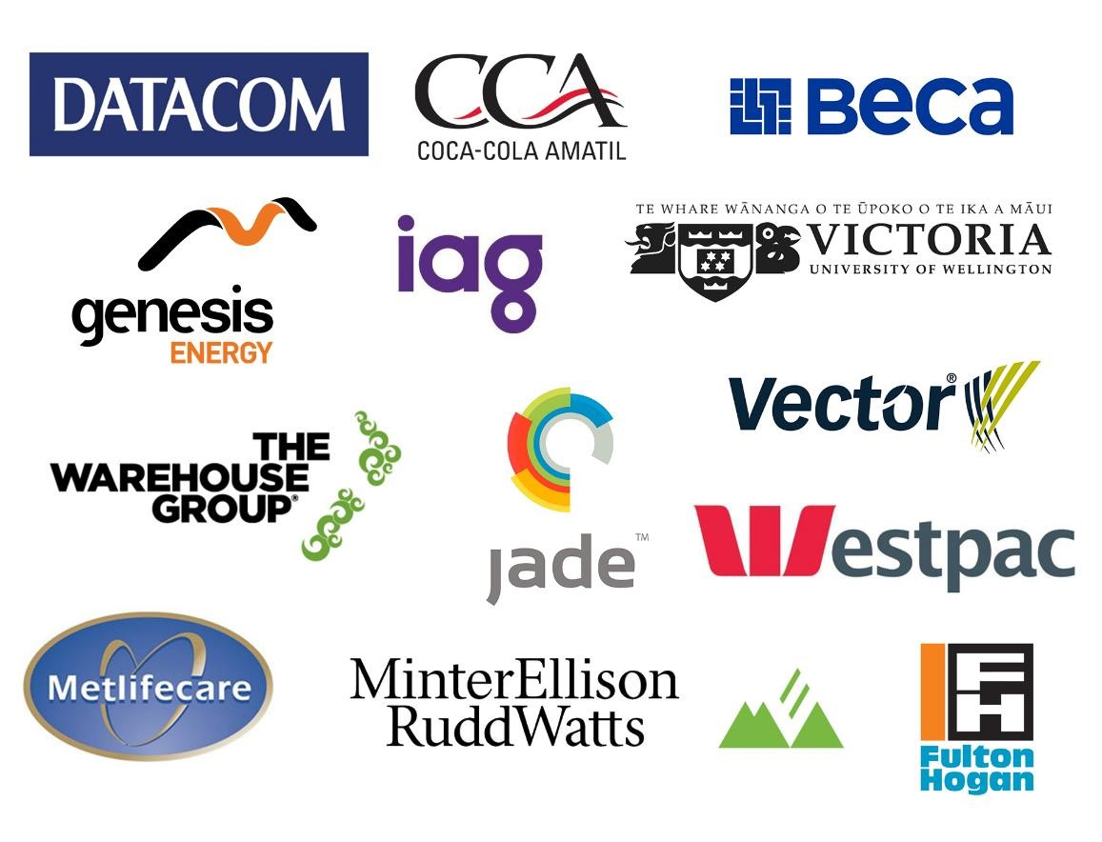








20% received full time offers
80% found the programme to accelerate their careers and opportunities
3800 students trained across 2016-18 and 260 given work placements
Notes:
What employers do we want?
Future pipeline
Those who can provide dedicated mentor/lead for the project
Mentorship and development opportunities
Can pay the minimum stipend to support student participation
Interesting and innovative projects
Driving young talent into the industry.

Slide 3
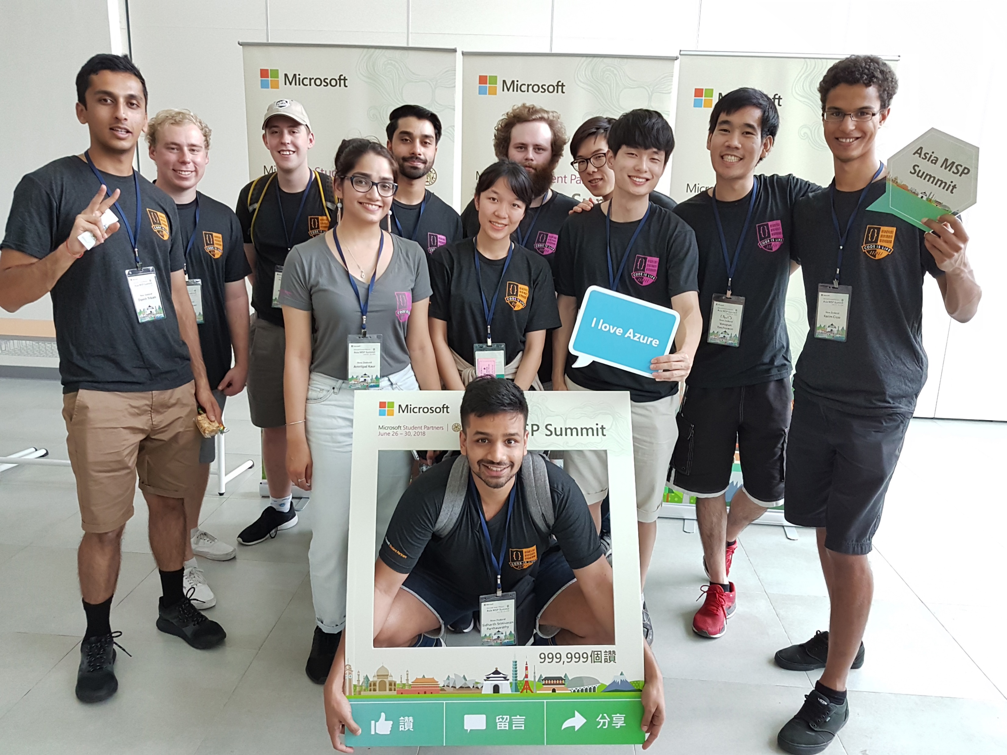

Microsoft Student Partners (MSP)

Slide 4
Timeline for 2019 MSA Program
April - July
Basic Training
July - August
Advanced Training
September
Employer Evening
November - February
Work Placement

Slide 5
MSA Experience
Technical Industry and Imagine Cup/Soft Skills training
Innovative project over a 10-week period with a team of 3
Provide mentorship and career development opportunities
Full-time wage or minimum compensation over the summer

Slide 6





Technical Training
Databases/API
Web App
AI and Machine learning
Big Data and Analytics
Serverless programming
Cognitive services

Slide 7

Hint
Notes:
Submission deadline: 1st of July
Videos will be published ~April 15th

Slide 8
Student | MSA Experience
Vicky

Slide 9
Student | MSA Experience
Reshad

Slide 10

Datacom

Slide 11
Kahoot! – Win some swag!
Preet/David

Slide 12
Questions

Slide 13


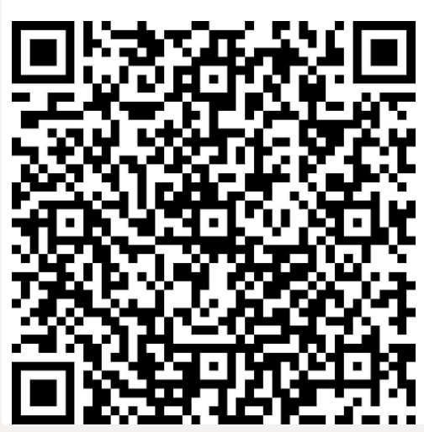
Sign up for communications
https://aka.ms/nzmsa
https://aka.ms/RegisterMSA

Slide 14
Food Time!

